Slide 1
TIER-Plus: providing evidence to support HIV service prioritization decisions
Prioritization under pressure
Alexandra de Nooy, Amsterdam UMC
16 September 2026

Slide 2
2
WHAT IS TIER-PLUS?
A “what-if” tool for HIV service prioritization and programme decisions
INPUTS
country epidemiology and
intervention coverage
It can be used to consider: what if Malawi did more of this and less of that?
SCENARIOS
change the
intervention mix
OUTPUTS
impact and cost over
one year
It compares choices side by side. It does not make the decision.
2
Notes:
Keep this plain — no jargon. “TIER-Plus is a what-if tool. You give it a country's current situation, you change the mix of interventions, and it estimates the consequences: infections avoided, cost, and who's reached. It lets you put options side by side. It does NOT make the decision for you.” Flag the one-year horizon now, honestly — we come back to why it matters on slide 10. [~1 min]

Slide 3
2
Back to our decisions
Not all prevention options can be prioritized at 100% coverage – how do we choose?
Oral PrEP
protect / expand the existing programme
Lenacapavir
introduce long-acting injectable PrEP
You told us what you'd want to know first:
acquisitions averted
costs & value for money
numbers & populations reached
coverage & unmet need
acceptability & equity
VMMC
protect / expand circumcision
Condoms
protect condom programming
3
Notes:
Recap the choice the audience just voted on, then pivot to their Poll 2 answers. “You were asked to prioritise across these four — and you told us what you'd want to know before deciding. Let me show you how much of that a tool like TIER-Plus can actually put in front of you, using Malawi's real starting numbers.”

Slide 4
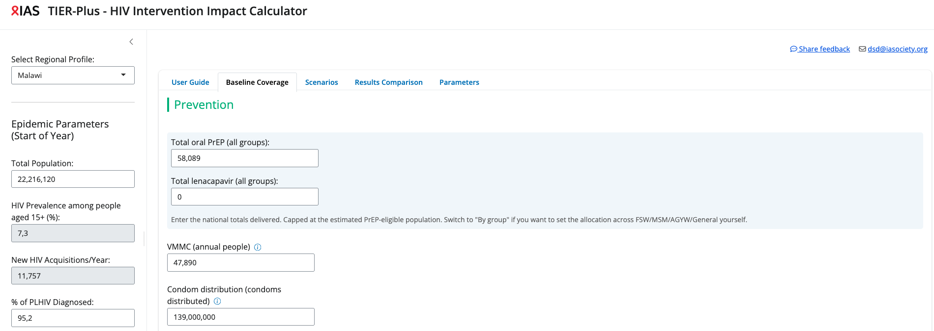
3
Prevention baseline
Malawi’s baseline prevention coverage
4
Notes:
Land the point that this is Malawi's REAL starting position, not a generic example. “This is where Malawi actually is — current coverage of each approach, and the gaps.

Slide 5
4
WHAT IF WE PRIORITISE DIFFERENTLY?
What if we changed our coverage of prevention services
1
2
Introduce Lenacapavir
Maintain overall number of people on PrEP by switching half of those on oral PrEP to Lenacapavir
Increase distribution of condoms
Increase the coverage of one of our less expensive interventions (per unit)
6
Notes:
Two fairly conservative scenarios – one in which we introduce new prevention tools like lenacapvir. Say by keeping the same total number of individual on Prep – but transition half from oral to lenacapvir. 2 priortitising our well known less costly interventions like condoms by increasing the numbers distributed

Slide 6
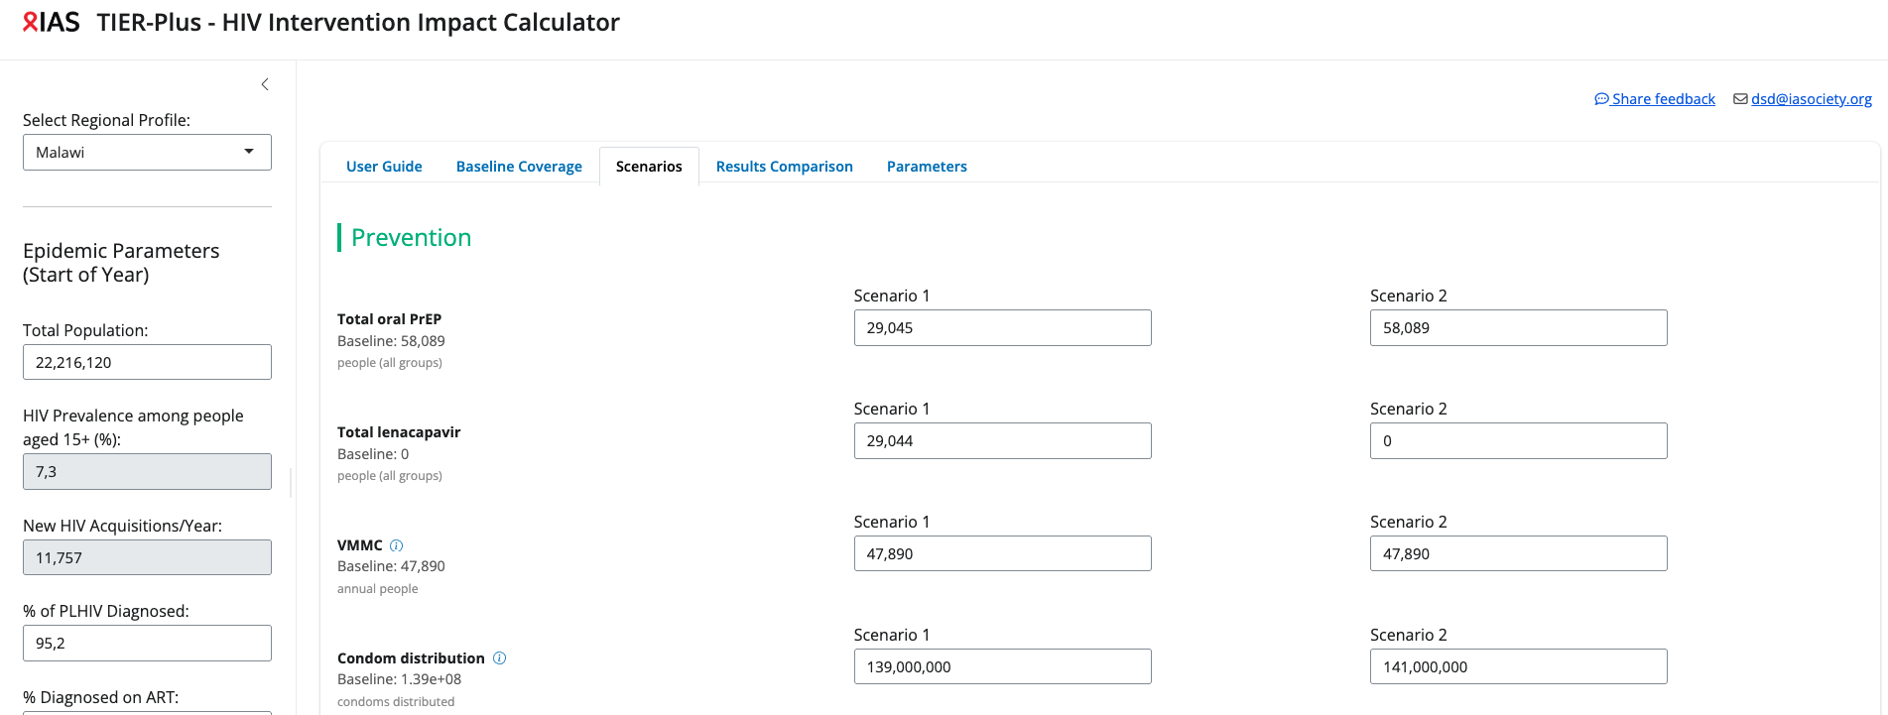

4
WHAT IF WE PRIORITISE DIFFERENTLY?
Building a scenario is just changing the numbers
5

Slide 7
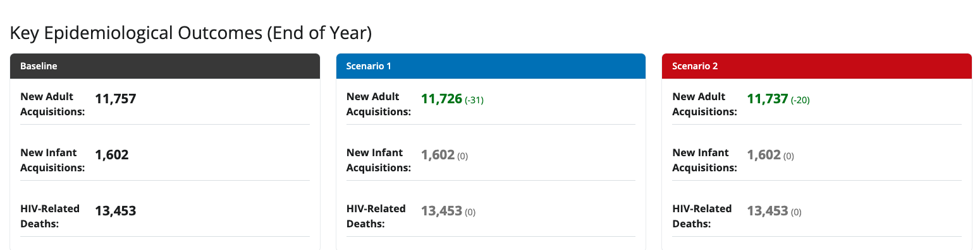
4
WHAT IF WE PRIORITISE DIFFERENTLY?
Trade-offs between scenarios – health outcomes
Relative to our baseline coverage both our scenarios - introducing lenacapavir and increasing condom distribution – reduced the overall number of estimated new adult acquisitions
7
Notes:
Note: the one-year time-frame limits the onwards effect of reduced infections visible in the tool – hence why some outcomes in the tool appear unaffected

Slide 8
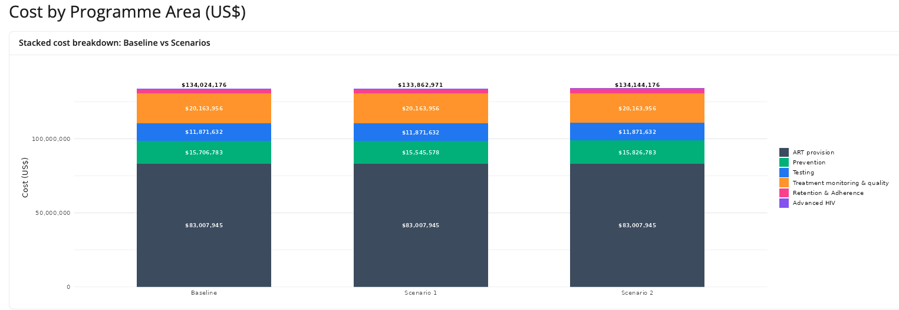
4
WHAT IF WE PRIORITISE DIFFERENTLY?
Trade-offs between scenarios – cost
7
Notes:
Because we focused on prevention interventions this is the only cost category affected

Slide 9
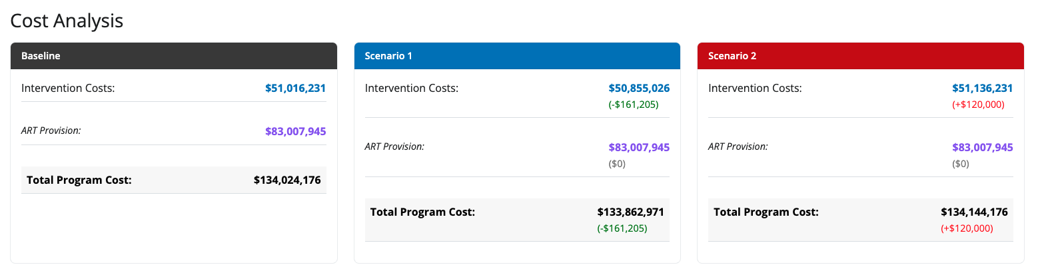
4
WHAT IF WE PRIORITISE DIFFERENTLY?
Trade-offs between scenarios – cost
7
Notes:
In both cases we saw fewer infections – however we saw differences in costs. Scenario 1 saved the progamme money, while scenario 2 increased the budget requirement slightly
These were fairly conservative scenarios – we could have kept oral prep the same but increase tripled lenacpavir or increased consoms by 10 million rather than one million. There are many ways to explore the tools and the intervention mix

Slide 10
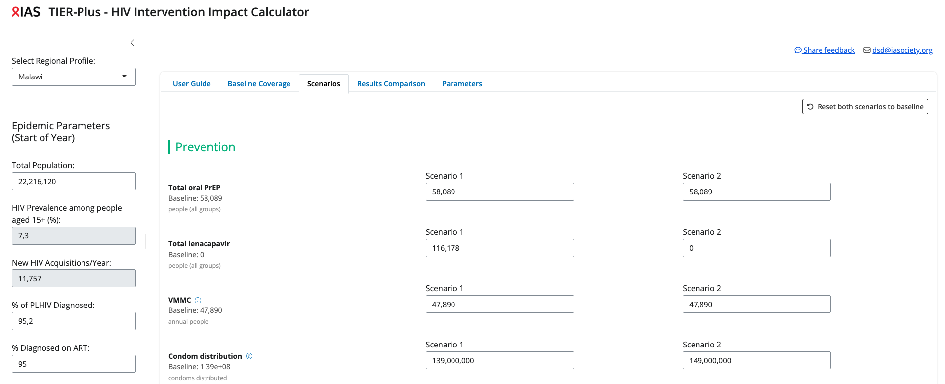
4
WHAT IF WE PRIORITISE DIFFERENTLY?
Same scenarios with less conservative implementation
Keep oral PrEP, put twice as many people on Lenacapavir
10 million additional condoms
5

Slide 11
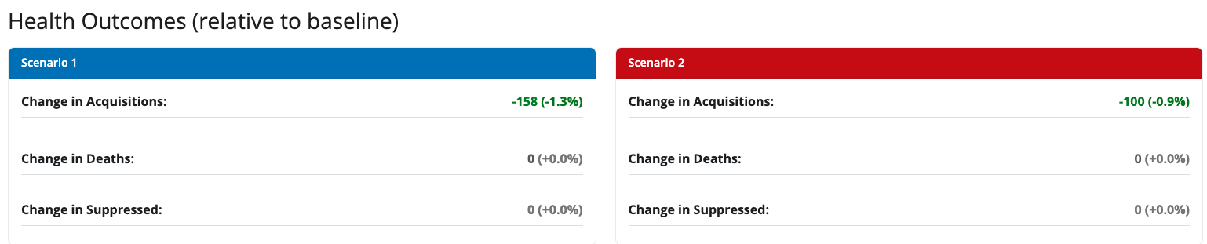
4
WHAT IF WE PRIORITISE DIFFERENTLY?
Trade-offs between scenarios – health outcomes
A greater number of acquisitions are averted relative to our more conservative versions of each scenarios
7

Slide 12
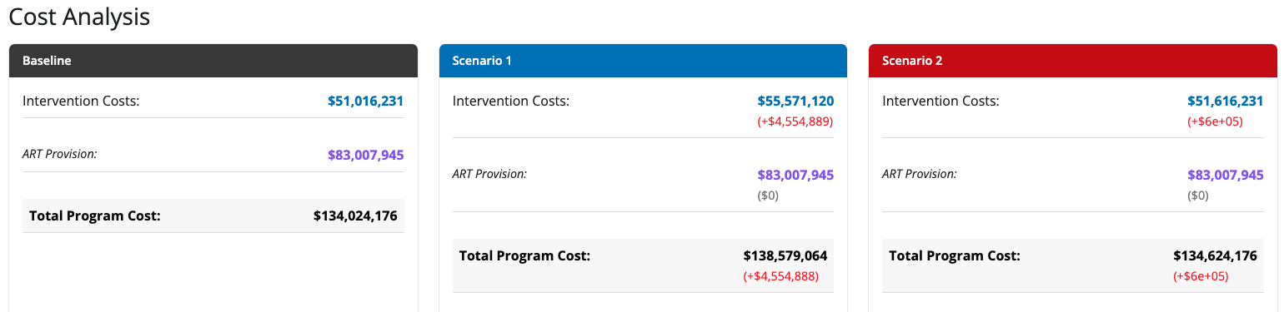
4
WHAT IF WE PRIORITISE DIFFERENTLY?
Trade-offs between scenarios – cost
7
Notes:
The degree to which you implement each greatly affects the cost – initially –scenario 1 was cost-saving but now its increases cost signficiantly

Slide 13
4
WHAT IF WE PRIORITISE DIFFERENTLY?
Comparing the trade-offs
Outcomes relative to baseline | Conservative scenarios |  | Ambitious scenarios
 | A Introducing lenacapavir | B Increasing condoms | A Introducing lenacapavir | B Increasing condoms
Infections averted | 31 | 20 | 158 | 100
Change in budget ($) | -161,205 | +120,000 | +4,554,888 | +600000
There is no single “correct” answer — the tool shows the trade-offs, stakeholders can use this information to make a final decision
8
Notes:
Shown two scenarions, and two version of each (one conservative and one more ambitious). Tier-plus tells us that all have positive helath impacts by reducing acqusitions – however, this is to different degrees and at different costs. What the correct version is the tool can’t say. However, it can provide key pirces of information to aid in discussions around these chocies. Notably, we focused on fairly simple eaxamples, and only on prevention. The tool can be layered across core programme elements (like prevention and testing together) and you can iterate and layer interventions on top of each other. For example, if we went back and created a third scenario where we used the healthgains from scenario 1, and increased the number of condoms only by the amount that we could afford with that cost difference.

Slide 14
5
WHAT TIER-PLUS CAN TELL YOU
What information can Tier-Plus provide?
TIER-Plus can help with
✓
Highlight current coverage & unmet need within interventions (in countries with validated data)
✓
Show trade-offs in health outcomes between scenarios e.g acquisitions averted or gained for prevention interventions
✓
Indicate likely cost differences between scenarios
✓
Contribute towards discussion and decisions surrounding the value for money of interventions
9
Notes:
We asked what information might be needed to help with making decisions. Tier plus can guide on some of them – list – but it cannot do all. Some of the key community and patients centered elements are missed by this tool

Slide 15
5
WHAT TIER-PLUS CAN’T TELL YOU
What information can Tier-Plus not provide?
✗
One-year horizon — under-counts long-run benefit — particularly relevant for prevention
✗
Constrained interventions — cannot model every intervention or element of implementation
✗
Not the whole picture — misses acceptability, lived experience and access barriers
✗
Not equity or rights — can’t easily weigh who is left behind
✗
Not why people choose — can't tell you why someone prefers one option over another
10

Slide 16
6
HOW COMMUNITIES CAN USE IT
Communities can use TIER to:
Challenge assumptions and ask sharper questions about proposed investments
Compare alternative scenarios and advocate for their consideration
Have discussions with other stakeholders using the same tool, with the same data and seeing the same outputs.
11
Notes:
this shifts a little power— communities shaping WHICH scenarios get modelled in the first place, not just reacting to options handed down.

Slide 17
THE KEY MESSAGE
TIER-Plus can’t tell Malawi (or any other country) what to prioritise. It makes the consequences of each choice visible — so decisions are transparent, evidence-based, and open to challenge.
12
Notes:
TIER-Plus cannot provide all the pieces of information needed to make decisions. It also can’t tell Malawi (or any other country) what to priorities. It is however aimed at making the consequences of each choice visible. Allowing decisions to be transparent and evidence-based while providing a platform that many different stakeholders can use to explore and challenge decisions from the same base. We’ve seen that while modelling can provide important numbers, these need to support other data and perspectives Tier cannot capture.

